Slide 1
Welcome to Software Engineering
USTH - Spring 2017
Truong Anh Hoang
Customized from © 2013 Armando Fox & David Patterson

Slide 2
Introduction
Truong Anh Hoang
PhD in Norway 2006
VNU-UET
http://uet.vnu.edu.vn/~hoangta

Slide 3
Learning outcomes
Understand key terminologies of modern software engineering
Able to use modern technologies, frameworks, techniques and tools to develop web-based app
Cloud computing, Angular, Rails, API, Agile, XP, TDD, CI,..
Experience various activities in developing a software product
Know how to make quality products

Slide 4

Learning methods
Learning by coding/ Project-based learning
Class hours
First half: review lecture
Second half: students presentation/discussion ⬅ you are here
After class hours
Self-study
CodeAcademy, MOOC courses, watch lectures
Homework
Projects
Online questions and answers
https://piazza.com/
Notes:
Temptation after 20 minutes, starting on time
Open to Facebook, tweet
Be quiet, during last minute

Slide 5

Textbook
Engineering Software as a Service: An Agile Approach Using Cloud Computing
Kindle Ebook $10
Watch lectures: Computer Science 169, 2015
https://www.youtube.com/playlist?list=PL-XXv-cvA_iCfQHHS7rxlfHFsU4aQW1IF
Online resources
http://www.saasbook.info/students
Notes:
Number the cards now –
Test colors now: Orange, Olive Green. Red, Blue
Have questions
Explain model – individual vote, discuss, pair vote

Slide 6
Other materials
Online tutorials, documentations, videos
Angular
NodeJS
Rails
TypeScript
…

Slide 7
Grading
Tentative
40% homework
40% projects
Focus on quality, not quantity
20% quizzes/exams
Notes:
SaaS touches lots of areas, so some people have CS186 (databases) vs. Ruby but not Data Bases, help out others
Proactive helping with correct and helpful answers in Piazza to help class

Slide 8
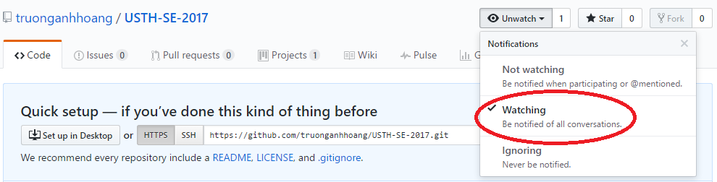
Course homepage
https://github.com/truonganhhoang/USTH-SE-2017/wiki
Now: create your github account and WATCH this project

Slide 9
Projects
Groups of three students
make team of ~3 students now and fill in this Google Sheet
http://bit.ly/2ofx8ru
Each group makes a web component cloning of a h5p component
https://h5p.org/content-types-and-applications

Slide 10
Homework
Personal homework and Group Projects
https://github.com/truonganhhoang/USTH-SE-2017/wiki

Slide 11
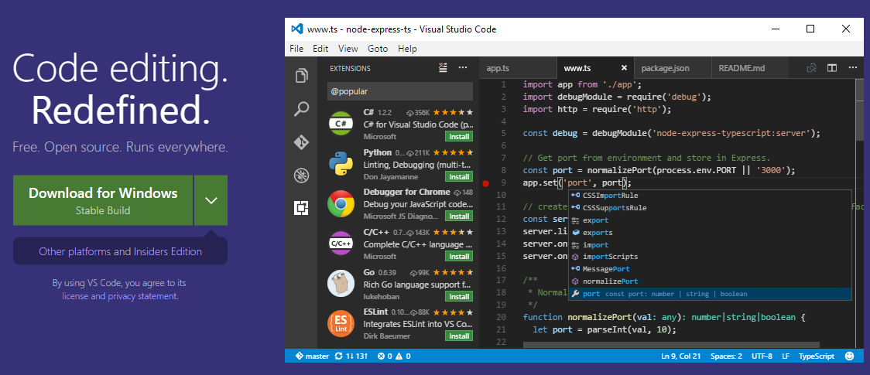
Recommendations
Use Visual Studio Code

